Slide 1


DATA WRANGLING AND DATA ACQUISITION
Handling and Analyzing Multiple Datasets Using Python: Pandas, NumPy, and Seaborn libraries.
Cleaning, Transforming, and Preparing Data for Analysis.
Upasna Agrawal

Slide 2
TABLE OF CONTENTS
Introduction
Libraries Used
Dataset 1: Import, Insights, describe
Dataset 2: Import, Insights, and Merging with Dataset 1
Merged Dataset: Insights, Handling Missing Values & Outliers
Dataset 3: Import, Concatenation, and Final Analysis
Conclusion

Slide 3

DATA ACQUISITION AND DATA WRANGLING
Data Wrangling its the process of converting raw data into a usable form. this involves cleaning, structuring, and enriching data so that it’s ready for analysis.
Imagine you’ve just received a huge dataset—it’s messy, with missing values, inconsistencies, and irrelevant information. data wrangling is like a toolkit that helps you tidy up this data, ensuring it’s organized and consistent.
Data Acquisition-this involves collecting the information required to understand electrical or physical phenomena.
data acquisition, also known as the process of collecting data, re­lies on specialized software­ that quickly captures, processes, and store­s information.

Slide 4
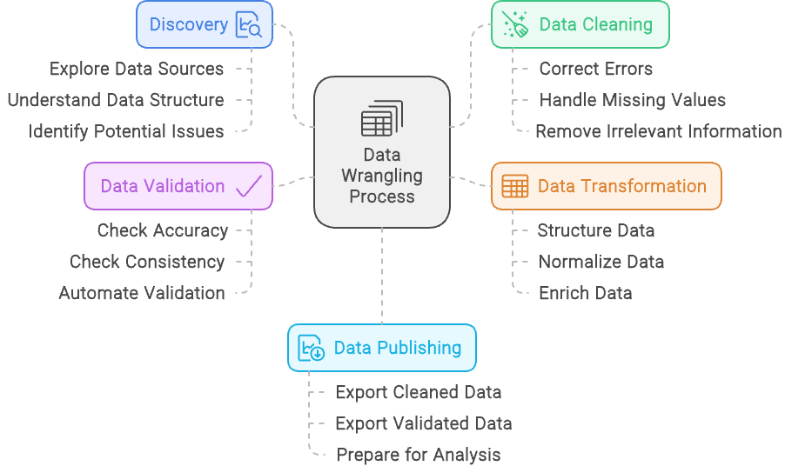
DATA WRANGLING PROCESS

Slide 5
PYTHON LIBRARIES FOR DATA WRANGLING
Pandas (Data manipulation, handling missing values, filtering)
NumPy (Handling numerical data)
Matplotlib/Seaborn (Data visualization)

Slide 6
OBJECTIVE
Handle three datasets effectively using Python libraries.
Perform cleaning, merging, and concatenation to extract insights.
Visualize data to uncover patterns.

Slide 7
KEY TASKS
Import datasets and check insights.
Handle missing values and outliers.
Merge and concatenate datasets.
Visualize data using Seaborn.

Slide 8
DATASET 1 – IMPORT & INITIAL ANALYSIS
Import Dataset 1: Load using pd.read_csv().
Insights:
Shape: Check with dataset1.shape.
Columns: List columns using dataset1.columns.
Data Types: Use dataset1.dtypes.
Null Values: Check with dataset1.isnull().sum().
Summary Statistics: Use dataset1.describe().

Slide 9
DATASET 2 – IMPORT & ANALYSIS
Import Dataset 2:
Load using pd.read_csv().
Insights:
Shape: Use Dataset2.shape.
Columns: Use Dataset2.columns.
Null Values: Check with Dataset2.isnull().sum().
Summary Statistics: Use Dataset2.describe()
Dropping unnessesary column "Unnamed: 0" of dataset_2 with dataset_2=dataset2.drop(["Unnamed: 0"],axis=1)

Slide 10

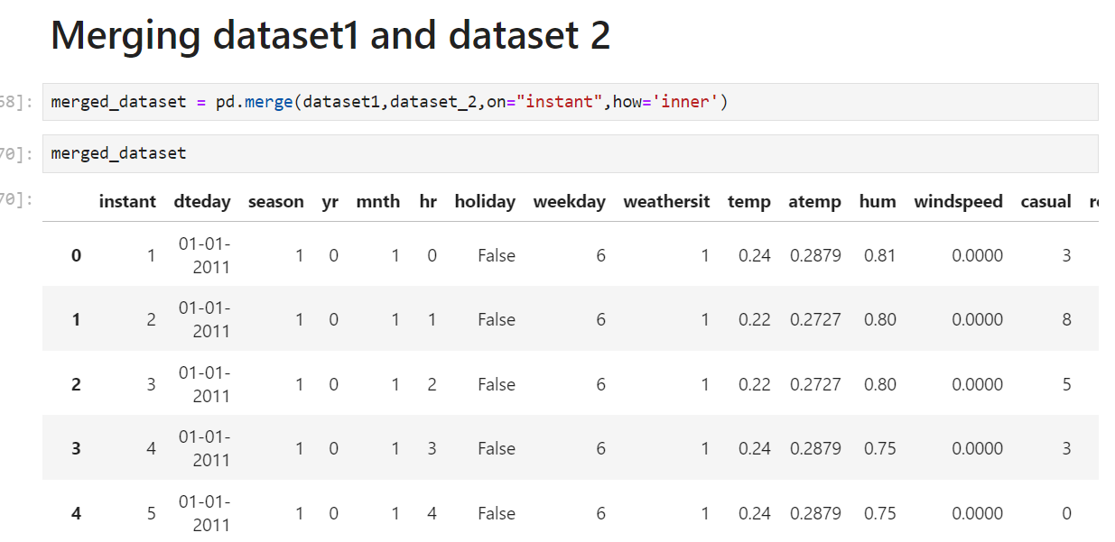
MERGING DATASET 1 & DATASET 2
Merge Datasets
Insights from Merged Dataset:
Handle Outliers: Use the 3-sigma rule to remove outliers:

Slide 11
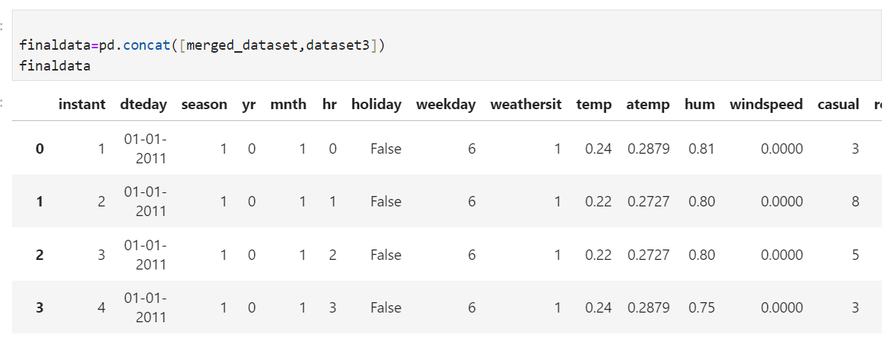
DATASET 3 – IMPORT & CONCATENATION
Import Dataset 3
Analysed Dataset3 with using of head, shape ,index columns.
Concatenate with Merged Dataset and named as finaldata
Insights from Final Data.
Shape: finaldata.shape
Null Values: finaldata.isnull().sum()
Summary Statistics: finaldata.describe()

Slide 12
HANDLING MISSING DATA:
Techniques:
Drop missing values: dataset.dropna()
Fill missing values: df.fillna(value)
dataset["atemp"].fillna(value=mean,inplace=True)
Handle Missing Values: filling "mean value" on nan value.
Handle Outliers:Using Z_score
f1.corr() # checking correlation of all data
f1.skew() # checking skewness of data

Slide 13
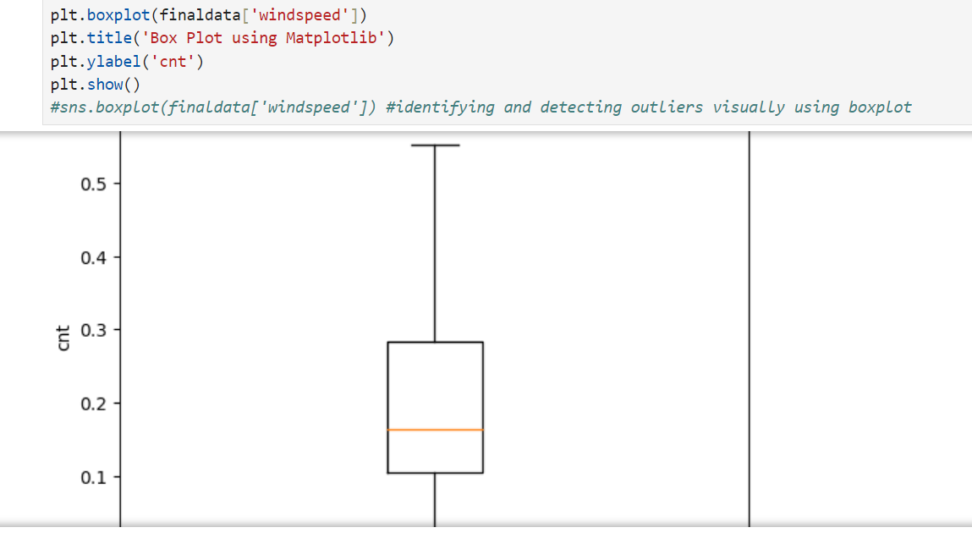
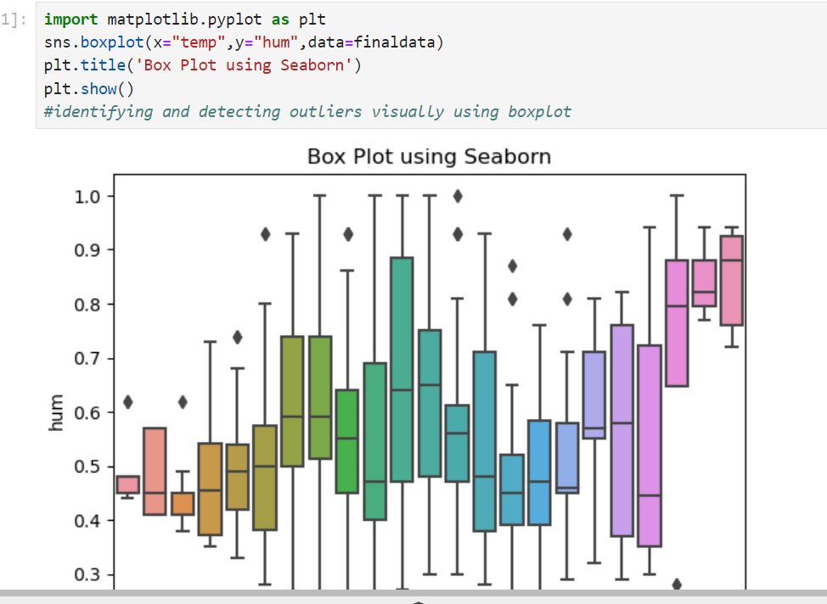
DATA VISUALIZATION
import seaborn as sns
Using regplot
Box plot

Slide 14
CONCLUSION
Successfully imported, analyzed, merged, and concatenated three datasets.
Handled missing values and outliers effectively.
Visualized the data to gain insights.

Slide 15

Thank you

